Slide 1
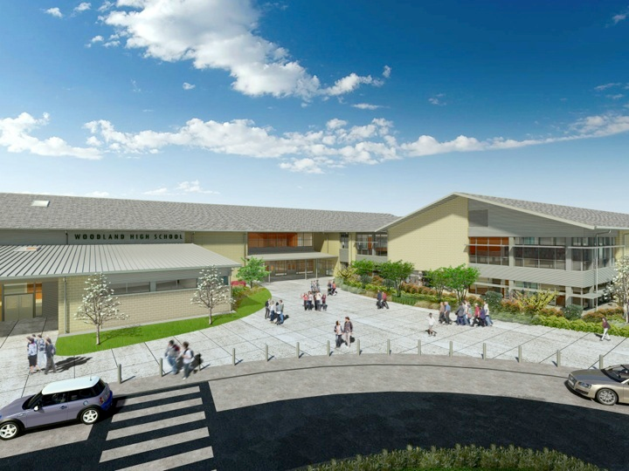
Woodland Public Schools
Facilities and Safety Report
December 2017

Slide 2
Piping failure WPS
A large section of the city water piping sprung a leak at the Primary School. This section of piping was scheduled for replacement during the upcoming summer break, due to multiple previous repairs. Due to the location of this leak and the remaining wall thickness of the piping, we were forced to complete this repair now. Approximately 150 feet of 3 inch and 1 ½ galvanized pipe were replaced with non-metal piping (PEX, crosslink polyethylene).
Emergency planning docs
The new emergency planning policy and procedure drafts were completed and sent to the Superintendent for review. This is a complete rewrite of both documents with detailed planning strategies for both District level and school level planning.
Meeting with Police Chief
Met with the Woodland Police Chief to discuss details of our emergency planning process and associated procedures. We discussed key topics of emergency planning including:
FACILITIES REPORT
Communication strategies
Incident Command System
Reunification locations and procedures
Traffic control
School and District Emergency plans
Standard Response Protocol (SRP)

Slide 3
Facilities Report Continued
Lighting WHS
We have experienced multiple lighting issues at WHS, including multiple failures of LED lights in the hallways, (currently around ten (10) fixtures partially out) dimming and control functions- Aux Gym, Main Gym, Commons and main hallway. Most recently we had a second failure of the UPS that caused a loss of control power to all external lighting. I am working these problems with Eaton, the LED lighting controller manufacturer through AET, and a couple of other contractors.
The following scheduled shutdown items were completed during the holiday break:
Cleaned out storm drain basins at three (3) schools, located drywell by Business Office, jetted drywell at gravel road between WPS/WMS
Installed two HEPA Fan Filter units in the ceramics lab at WHS
Annual SWCAA compliance report and boiler combustion testing at WPS, WMS, WHS
Demolished house adjacent to WIS
Resurfaced green gym floor at WMS
Multiple electrical repairs/ projects (including FFU’s CNC)
Installed Mazak CNC in WHS auto shop
Completed the installation of seven (7) exterior cameras at WIS
Numerous sheetrock repairs and painting projects at WMS and WHS
Installed synthetic wall panels in WMS kitchen
Annual department occupational safety and department training
Installed sidewalk for special education students at WPS and island crossover sidewalk at WHS

Slide 4
Facilities Report Continued
Projects scheduled but not completed:
Re-key WMS, waiting on schedule from contractor
Replace hotline bath at WIS kitchen (waiting on part), caulk WHS hot serving line – manpower limited
Installation of weather stations at WHS and WMS – manpower limited
EWF (engineered wood fibers) at WIS and WPS- waiting on blower truck availability

Slide 5
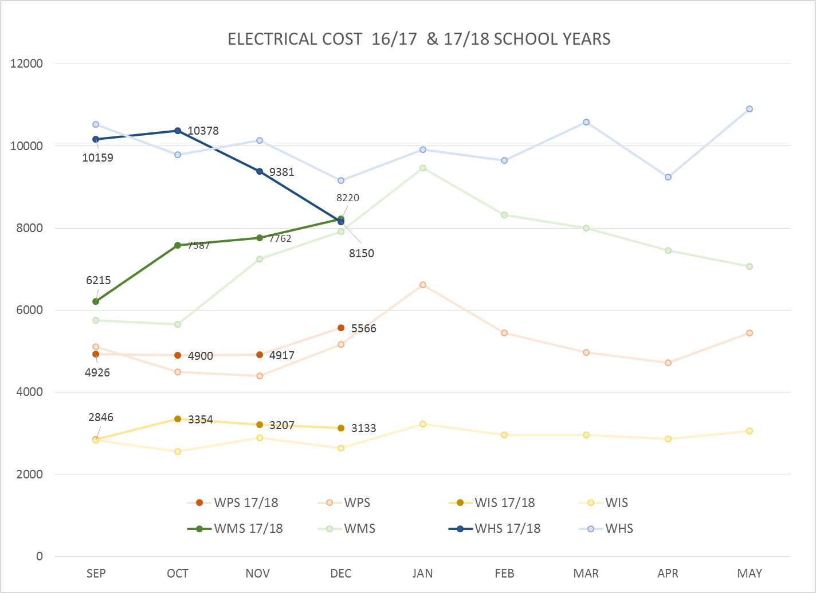
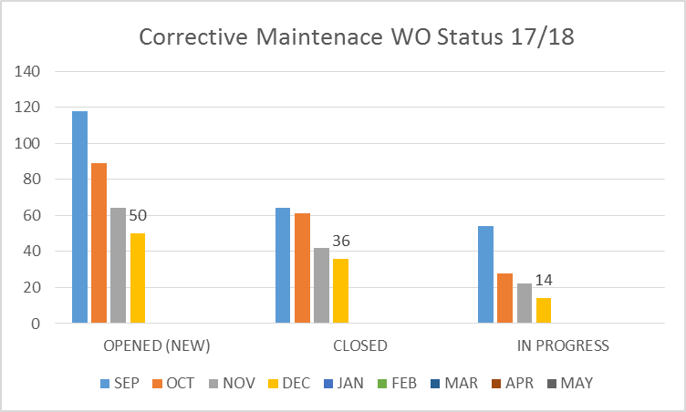
FACILITY CHARTS – POWER COST AND WORK ORDER STATUS

Slide 6
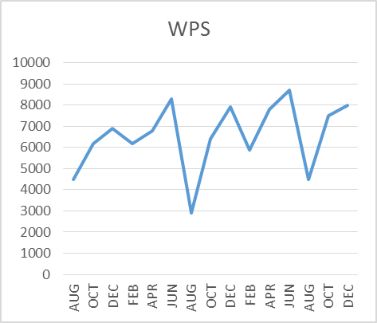
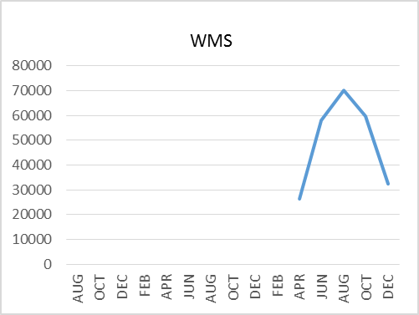
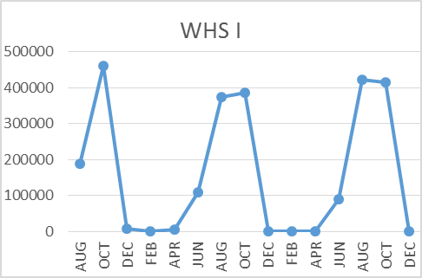
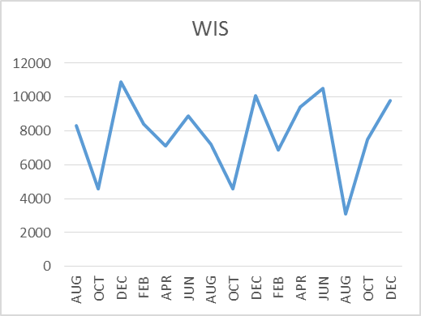
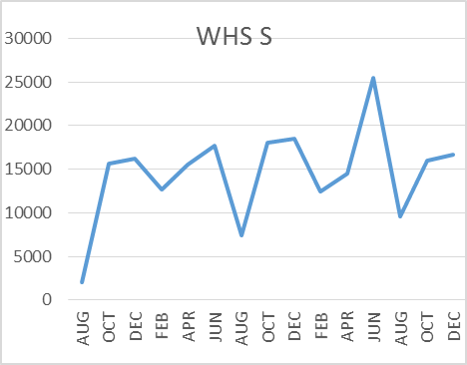
FACILITY CHARTS –
WATER USAGE
WHS, WIS, WMS, WPS
Water charts are updated every two
months, next update to these charts
in March 2018
The WMS chart includes; 755 Park high and low flow, BO and Team High, Pit house, bus barn, athletic field and DO. All of these meters are totaled on the WMS graph, but each data point is recorded separately to aid in identifying leaks.

Slide 7
SAFETY REPORT
Accidents for the month
There was one (1) student injury and three (3) staff incidents/accidents
Staff Accidents/Incidents
WPS - Student threw object at staff member, contusion
WPS - Student struck staff members leg, contusion
Student Accidents/Injuries (8)
WHS (Team High) student pinched finger in door, minor laceration

Slide 8
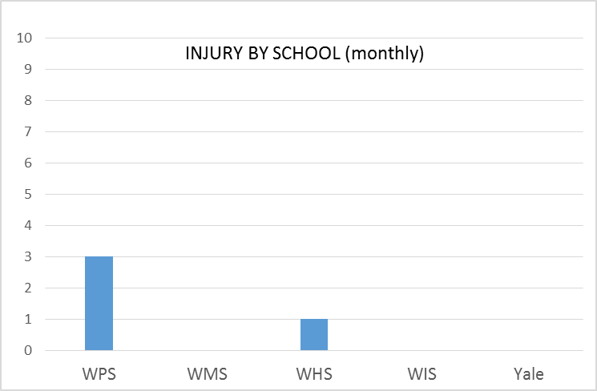
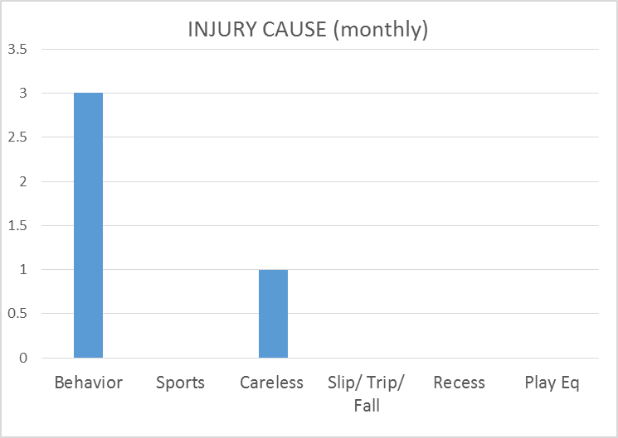
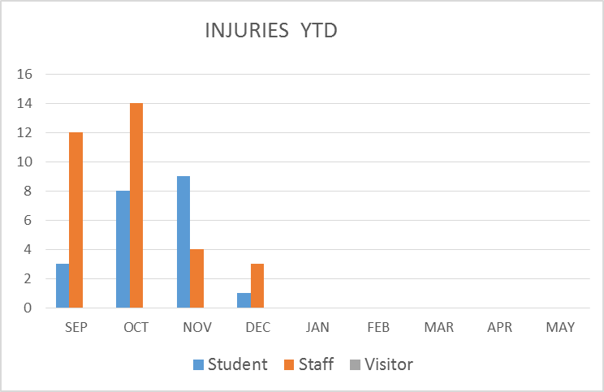
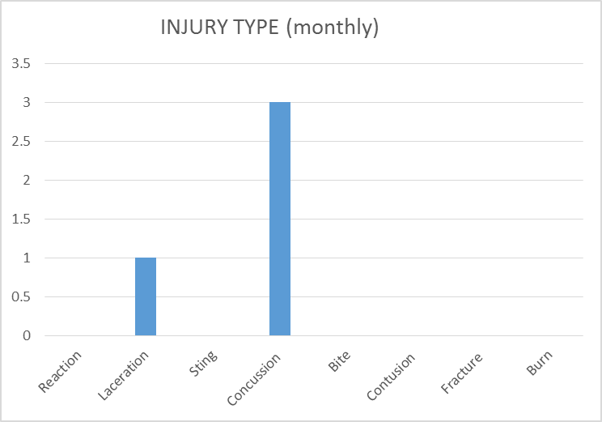
SAFETY CHARTS

